Slide 1
Microgrids (Part I)
Introduction and Energy Management
EE 653 Power distribution system modeling, optimization and simulation
GRA: Qianzhi Zhang
Advisor: Dr. Zhaoyu Wang
Department of Electrical and Computer Engineering
Iowa State University

Slide 2
Contents
Introduction of Microgirds (MGs)
  MGs concept
  MGs basic components
  MGs typical configuration
  MGs category
  MGs advantages/disadvantages
  MGs control
Research Topics: networked MGs
  Optimization-based decision making
    Centralized coordination of networked MGs
    Decentralized coordination of networked MGs
    Decentralized coordination of MGs for self-healing operation
    Restoration with networked MGs formation
  Learning-based decision making
    Power management of networked MGs under incomplete information
Real MG Case

Slide 3
The Concept of MG
  A MG is a localized small-scale power system that clusters and manages distributed energy resources (DERs) and loads within a defined electrical boundary and point of common coupling (PCC).
Fig. 1 Schematic diagram of a generic multiple-DER MG [1]
[1] D. E. Olivares et al., "Trends in Microgrid Control," in IEEE Transactions on Smart Grid, vol. 5, no. 4, pp. 1905-1919, July 2014.
Notes:
What is MG???? Standard definisions

Slide 4
Basic MG Components
The MG components to be modeled in the MG optimal scheduling/operation/control problem include loads, local generating units, and energy storage systems connected through an low voltage (LV) distribution network [1].
1. Local Generations
  A MG presents various types of generation sources that feed electricity, heating, and cooling to users.
  These sources are divided into two major groups: (i) thermal energy sources (e.g,. natural gas or biogas generators or micro combined heat and power); (ii) renewable generation sources (e.g., wind turbines, solar generations).
2. Loads
  - In a MG, consumption simply refers to elements that consume electricity, heat, and cooling which range from single devices to lighting, heating system of buildings, commercial centers, etc. In the case of controllable loads, the electricity consumption can be modified in demand of the network.
[1] D. E. Olivares et al., "Trends in Microgrid Control," in IEEE Transactions on Smart Grid, vol. 5, no. 4, pp. 1905-1919, July 2014.

Slide 5
Basic MG Components
3. Energy Storages
  The primary application of energy storage systems is to coordinate with generation resources to guarantee the MG generation adequacy.
  Energy storage systems can also be used for load shifting, where the stored energy at times of low prices is generated back to the MG when the market price is high. This action is analogous to shifting the load from high price hours to low price hours.
  Energy storage systems also play a major role in MG islanding application.
4. Point of Common Coupling
  It is the point in the electric circuit where a MG is connected to a main grid.
  MGs that do not have a PCC are called isolated MGs which are usually presented in the case of remote sites
[1] D. E. Olivares et al., "Trends in Microgrid Control," in IEEE Transactions on Smart Grid, vol. 5, no. 4, pp. 1905-1919, July 2014.

Slide 6
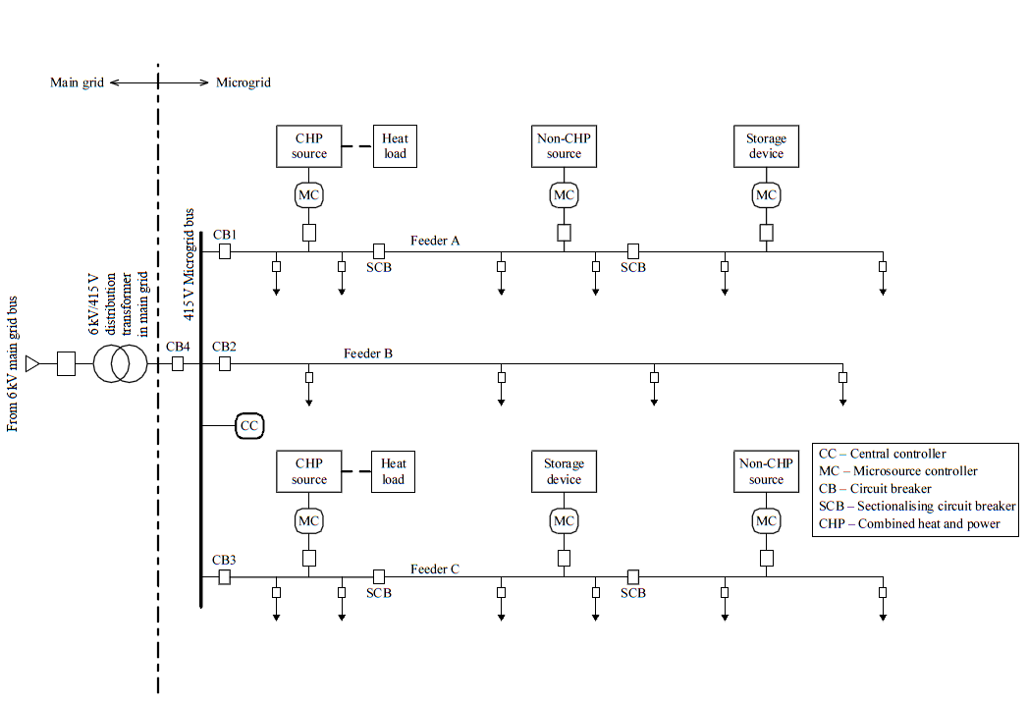
Typical Configuration of MG
Fig. 2 A typical MG Configuration [2]
[2] Series, I. R. E. "Microgrids and active distribution networks." The Institution of Engineering and Technology, 2009
Notes:
Resolution too low

Slide 7
MG Configuration
A MG is coupled with the main utility grid (denoted as ‘main grid’) through the PCC circuit breaker.
A MG is operated in two modes: (1) grid-connected and (2) standalone [2].
  In grid-connected mode, a MG remains connected to the main grid either totally or partially, and imports or exports power from or to the main grid.
  In case of any disturbance in the main gird, the MG switches over to stand-alone mode while still feeding power to the priority loads.
[2] Series, I. R. E. "Microgrids and active distribution networks." The Institution of Engineering and Technology, 2009

Slide 8
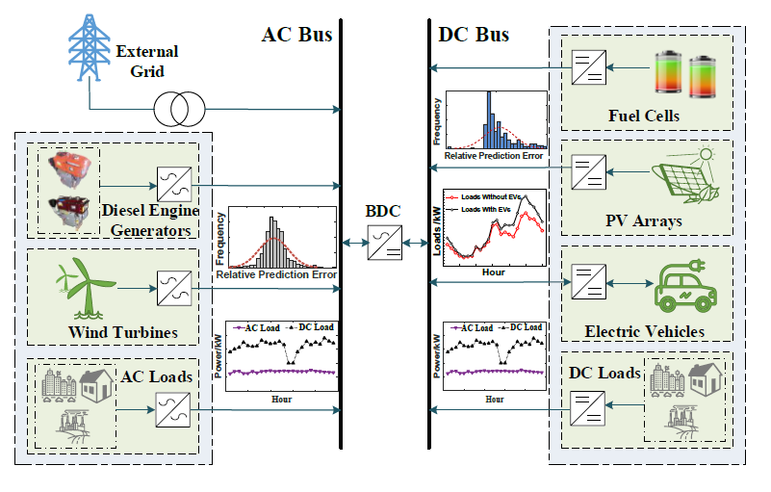
Typical Configuration of hybrid AC/DC MG
Compared to conventional AC and DC MG, hybrid can provide a more effective solution for the integration of system components that are inherently AC and DC oriented. A typical configuration of a hybrid AC/DC can be divided into two components:
  an AC-based subgrid connected with diesel generator, wind turbines and AC loads
  an DC-based subgrid integrating fuel cells, PVs, electric vehicles and DC loads
The two subgrids are linked by a bi-directional converters.
Advantages of Hybrid AC/DC MGs :
  Reduce investment costs by greatly reducing the number of electronic power converters
  Minimize conversion loss by eliminating unnecessary multi-conversion processes
  Enhance nodal reliability because of the availability of alternative resources
  Maximize the utilization of renewable power generation
  Realize power mutual-balance through the bi-directional converter between the AC and DC subgrids
Fig. 3 A typical hybrid AC/DC MG [3]
[3] Z. Liang, H. Chen, X. Wang, S. Chen and C. Zhang, "A Risk-Based Uncertainty Set Optimization Method for the Energy Management of Hybrid AC/DC Microgrids with Uncertain Renewable Generation," in IEEE Transactions on Smart Grid, Early access.
Notes:
Resolution too low

Slide 9

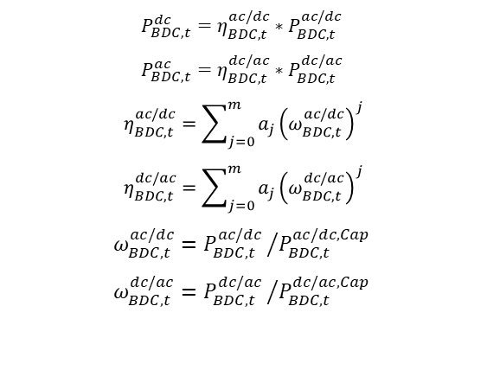
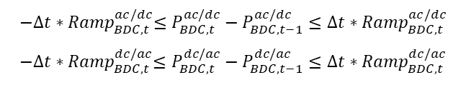
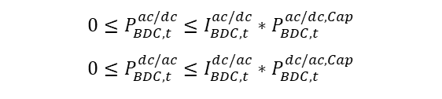
Typical Configuration of hybrid AC/DC MG
The bi-directional converter (BDC) has a critical role in balancing power flow between the AC and DC subgrids. The detailed constraints of the BDC are presented as follows:
$$I_{BDC,t}^{ac/dc}+I_{BDC,t}^{dc/ac}≤1,I_{BDC,t}^{ac/dc},I_{BDC,t}^{dc/ac}∈\{0,1\}$$
BDC state constraint, which ensures that power does not flow in both direction simultaneously
$${0≤P}_{BDC,t}^{ac/dc}≤I_{BDC,t}^{ac/dc}{∗P}_{BDC,t}^{ac/dc, Cap}$$
$${0≤P}_{BDC,t}^{dc/ac}≤I_{BDC,t}^{dc/ac}{∗P}_{BDC,t}^{dc/ac, Cap}$$
Constraints of the range of the BDC exchange power
$$−{{∆t∗Ramp}_{BDC,t}^{ac/dc}≤P}_{BDC,t}^{ac/dc}−P_{BDC,t−1}^{ac/dc }≤{∆t∗Ramp}_{BDC,t}^{ac/dc}$$
$$−{{∆t∗Ramp}_{BDC,t}^{dc/ac}≤P}_{BDC,t}^{dc/ac}−P_{BDC,t−1}^{dc/ac }≤{∆t∗Ramp}_{BDC,t}^{dc/ac}$$
Constraints of the ramping power exchange limits of the BDC
The exchange power between the AC and DC subgrids is associated with the BDC conversion efficiency $η_{BDC,t}^{ac/dc}$ and the BDC utilization ration $ω_{BDC,t}^{ac/dc}$
$$P_{BDC,t}^{dc}=η_{BDC,t}^{ac/dc}{∗P}_{BDC,t}^{ac/dc }$$
$$P_{BDC,t}^{ac}=η_{BDC,t}^{dc/ac}{∗P}_{BDC,t}^{dc/ac }$$
$$η_{BDC,t}^{ac/dc}=\sum_{j=0}^{m}{a_{j}{\left(ω_{BDC,t}^{ac/dc}\right)}^{j}}$$
$$η_{BDC,t}^{dc/ac}=\sum_{j=0}^{m}{a_{j}{\left(ω_{BDC,t}^{dc/ac}\right)}^{j}}$$
$$ω_{BDC,t}^{ac/dc}={P_{BDC,t}^{ac/dc }}/{P_{BDC,t}^{ac/dc,Cap }}$$
$$ω_{BDC,t}^{dc/ac}={P_{BDC,t}^{dc/ac }}/{P_{BDC,t}^{dc/ac,Cap }}$$
Calculate the power from the BDC to the AC and DC subgrids
[3] Z. Liang, H. Chen, X. Wang, S. Chen and C. Zhang, "A Risk-Based Uncertainty Set Optimization Method for the Energy Management of Hybrid AC/DC Microgrids with Uncertain Renewable Generation," in IEEE Transactions on Smart Grid, Early access.
Notes:
Resolution too low

Slide 10
MG Categories
Most MGs can be further described by the following four categories [4]:
(1) Campus Environment/Institutional MG
The focus of campus micro-grids is aggregating existing on-site generation with multiple loads that located in tight geography in which owner easily manage them.
(2) Remote Off-grid MGs
These micro-grids never connect to the macro-grid and instead operate in an island mode at all times because of economical issue or geography position. Typically, an "off-grid" micro-grid is built in areas that are far distant from any transmission and distribution infrastructure and, therefore, have no connection to the utility grid.
(3) Military Base MGs
These MGs are being actively deployed with focus on both physical and cyber security for military facilities in order to assure reliable power without relying on the macro-grid.
[4] Ward Bower, Dan Ton, Ross Guttromson, “The Advanced Micro-grid Integration and Interoperability,“ Sandia National Laboratories, 2014

Slide 11
MG Categories
(4) Commercial and Industrial MGs
These types of micro-grids are maturing quickly in North America and Asia Pacific; however, the lack of well –known standards for these types of micro-grids limits them globally. Main reasons for the installation of an industrial micro-grid are power supply security and its reliability. There are many manufacturing processes in which an interruption of the power supply may cause high revenue losses and long start-up time.
Tab. 1 DOE MG Program Application-Power Categories [4]
Commercial | >50kW, three-phase and functionally expandable
Community/Campus | 1-10 MW may be modular or single rating
Utility Scale | >10 MW possibly using multiple interconnected micro-grid
[4] Ward Bower, Dan Ton, Ross Guttromson, “The Advanced Micro-grid Integration and Interoperability,“ Sandia National Laboratories, 2014

Slide 12
Technical and Economical Advantages of MG
The development of MG is very promising for the electric energy industry because of the following advantages [2]:
1. Environmental issues – It is needless to say that MGs would have much lesser environmental impact than the large conventional thermal power stations. However, it must be mentioned that the successful implementation of carbon capture and storage schemes for thermal power plants will drastically reduce the environmental impacts. Nevertheless, some of the benefits of MG in this regard are as follows:
  Reduction in gaseous and particulate emissions due to close control of the combustion process may ultimately help combat global warming
  Physical proximity of customers with microsources may help to increase the awareness of customers towards judicious energy usage.
[2] Series, I. R. E. "Microgrids and active distribution networks." The Institution of Engineering and Technology, 2009

Slide 13
Technical and Economical Advantages of MG
2. Operation and investment issues – Reduction of physical and electrical distance between microsource and loads can contribute to:
  Improvement of reactive support of the whole system, thus enhancing the voltage profile.
  Reduction of Transmission & Distribution (T & D) feeder congestion.
  Reduction of T & D losses.
  Reduction/postponement of investments in the expansion of transmission and generation systems by proper asset management.
3. Resilience and reliability – Improvement in power resilience and reliability is achieved due to :
  Decentralization of supply.
  Better match of supply and demand.
  Reduction of the impact of large-scale transmission and generation outages.
  Minimization of downtimes and enhancement of the restoration process through black start operations of microsources.
[2] Series, I. R. E. "Microgrids and active distribution networks." The Institution of Engineering and Technology, 2009

Slide 14
Challenges and Disadvantages of MG’s Development
In spite of potential benefits, development of MGs suffers from several challenges and potential drawback as follows [1], [2]:
1. Bidirectional power flows:
  While distribution feeders were initially designed for unidirectional power flow, integration of DG units at low voltage levels can cause reverse power flows and lead to complications in protection coordination, undesirable power flow patterns, fault current distribution, and voltage control.
2. Stability issues:
  Local oscillations may emerge from the interaction of the control systems of DG units, requiring a thorough small-disturbance stability analysis. Moreover, transient stability analyses are required to ensure seamless transition between the grid-connected and stand-alone modes of operation in a MG.
[1] D. E. Olivares et al., "Trends in Microgrid Control," in IEEE Transactions on Smart Grid, vol. 5, no. 4, pp. 1905-1919, July 2014.
[2] Series, I. R. E. "Microgrids and active distribution networks." The Institution of Engineering and Technology, 2009

Slide 15
Challenges and Disadvantages of MG’s Development
3. Low inertia
  Unlike bulk power systems where high number of synchronous generators ensures a relatively large inertia, MGs might show a low-inertia characteristic, especially if there is a significant share of power electronic-interfaced DG units. Although such an interface can enhance the system dynamic performance, the low inertia in the system can lead to severe frequency deviations in stand-alone operation if a proper control mechanism is not implemented.
  Grid-forming virtual inertia devices are developed for fast frequency response for low inertia system.
4. Uncertainty
  Taking into account the uncertainty of parameters such as load profile and weather forecast. This uncertainty is higher than those in bulk power systems, due to the reduced number of loads and highly correlated variations of available energy resources (limited averaging effect).
[1] D. E. Olivares et al., "Trends in Microgrid Control," in IEEE Transactions on Smart Grid, vol. 5, no. 4, pp. 1905-1919, July 2014.
[2] Series, I. R. E. "Microgrids and active distribution networks." The Institution of Engineering and Technology, 2009

Slide 16
Challenges and Disadvantages of MG’s Development
5. High costs of distributed energy resources
  The high installation cost for MGs is a great disadvantage. This can be reduced by arranging some form of subsidies from government bodies to encourage investments.
6. Administrative and legal barriers
  In most counties, no standard legislation and regulations are available to regulate the operation of MGs. Governments of some countries are encouraging the establishment of green power MGs, but standard regulations are yet to be framed for implementation in future.
7. Market monopoly
  In the MGs are allowed to supply energy autonomously to priority loads during any main grid contingency, the main question that arises is who will then control energy supply prices during the period over when main grid is not available. Since the main grid will be disconnected and the current electricity market will lose its control on the energy price. However, MGs might retail energy at a very high price exploiting market monopoly.
[1] D. E. Olivares et al., "Trends in Microgrid Control," in IEEE Transactions on Smart Grid, vol. 5, no. 4, pp. 1905-1919, July 2014.
[2] Series, I. R. E. "Microgrids and active distribution networks." The Institution of Engineering and Technology, 2009

Slide 17
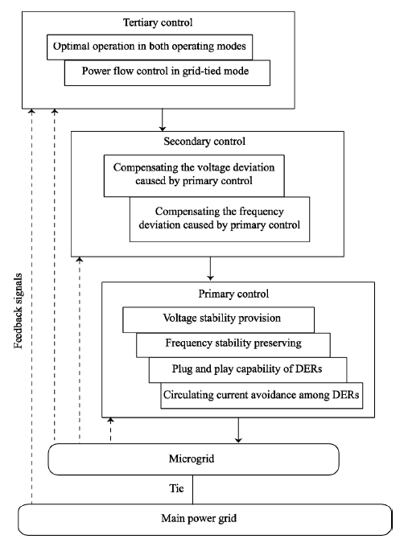
MG Control
The primary control maintains voltage and frequency stability of the microgrid subsequent to the islanding process.
The secondary control compensates for the voltage and frequency deviations caused by the operation of the primary controls.
The tertiary control manages the power flow between the microgrid and the main grid and facilitates an economically optimal operation.
Fig. 4.1 Hierarchical control levels of a MG [5]
[5] A. Bidram and A. Davoudi, "Hierarchical Structure of Microgrids Control System," in IEEE Transactions on Smart Grid, vol. 3, no. 4, pp. 1963-1976, Dec. 2012.

Slide 18
MG Control
As seen in Fig. 4, the MG control system can be categorized into three levels, namely, primary, secondary and tertiary [5]:
Primary control
  To stabilize the voltage and frequency. Subsequent to an islanding event, the MG may lose its voltage and frequency stability due to the mismatch between the power generated and consumed.
  To offer plug and play capability for DERs and properly share the active and reactive power among them, preferably, without any communication links.
  To provide the reference points for the control loops of DERs.
Secondary control
  As a centralized controller, secondary control restores the MG voltage and frequency and compensate for the deviations caused by the primary control.
  Secondary control is designed to have slower dynamics response than that of the primary.
[5] A. Bidram and A. Davoudi, "Hierarchical Structure of Microgrids Control System," in IEEE Transactions on Smart Grid, vol. 3, no. 4, pp. 1963-1976, Dec. 2012.

Slide 19
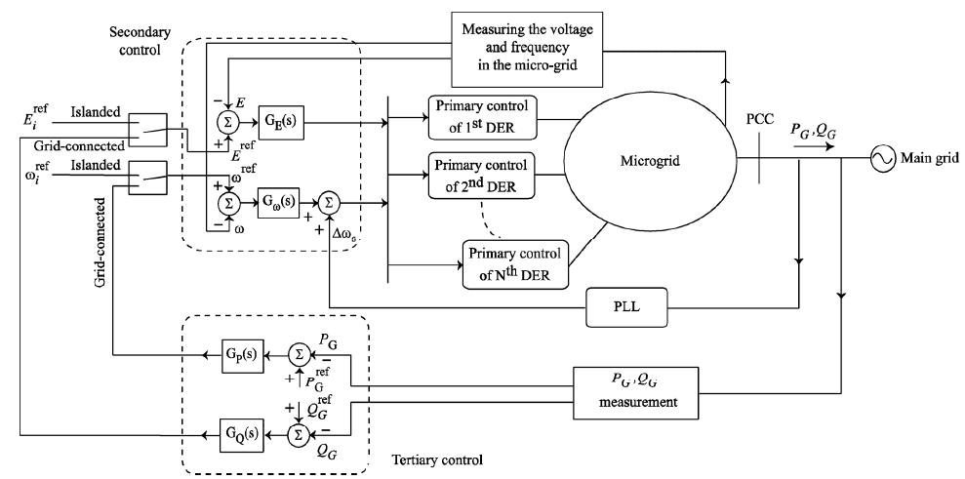
MG Control
3. Tertiary control
  Tertiary control is the last and the slowest control level that considers the economical concerns in the optimal operation of the MG, and manages the power flow between MG and main grid.
Fig. 4.2 Hierarchical control levels of a MG [5]
[5] A. Bidram and A. Davoudi, "Hierarchical Structure of Microgrids Control System," in IEEE Transactions on Smart Grid, vol. 3, no. 4, pp. 1963-1976, Dec. 2012.

Slide 20
Research topic: Networked MGs
Optimization-based decision making
  Centralized coordination of networked MGs
  Decentralized coordination of networked MGs
  Decentralized coordination of MGs for self-healing operation
  Restoration with networked microgrids formation
Learning-based decision making
  Power management of networked MGs under incomplete information

Slide 21
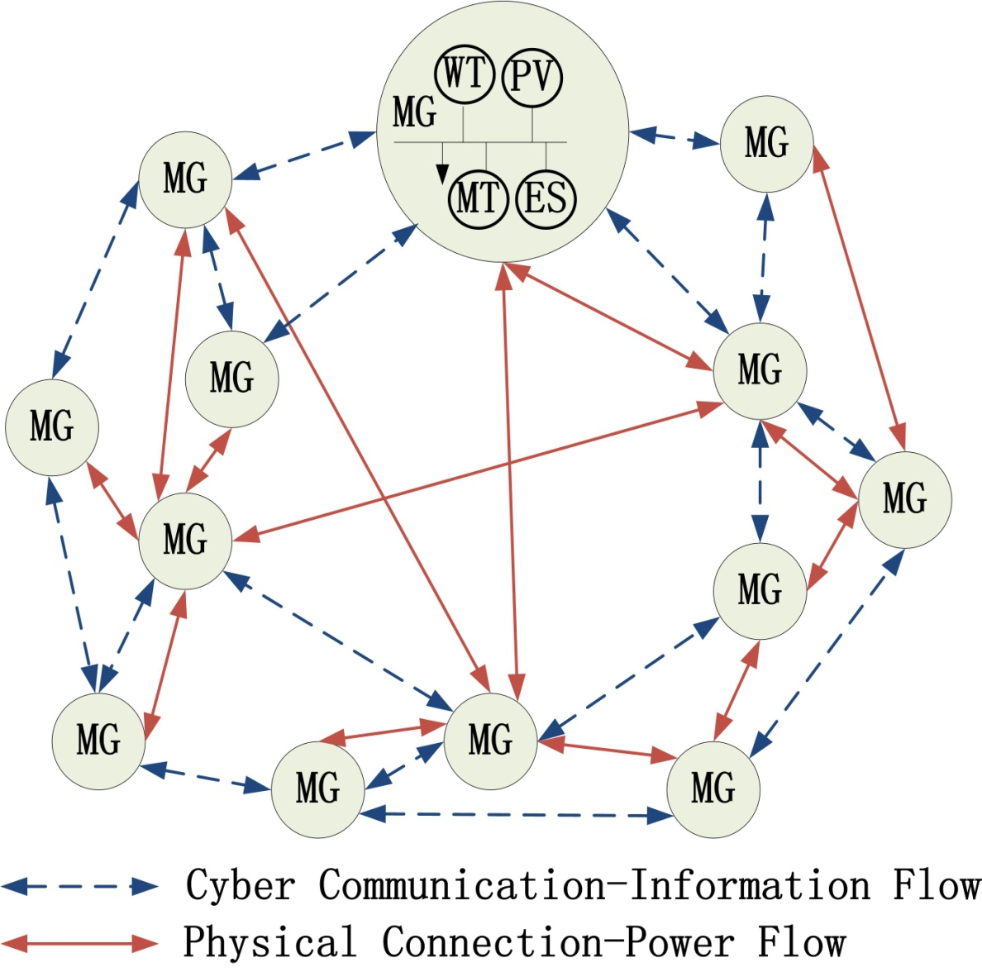
Networked MGs
Networked microgrids can support and interchange power with each other
Highly desirable when utilities are not accessible (e.g., in an island or a military base) or lost (e.g., utility grids are down)
Economic energy exchange in normal operation
Energy support for self-healing
Fig. 5 Concept of networked MGs [6]
[6] Z. Wang, B. Chen, J. Wang and C. Chen, "Networked Microgrids for Self-Healing Power Systems," in IEEE Transactions on Smart Grid, vol. 7, no. 1, pp. 310-319, Jan. 2016.

Slide 22
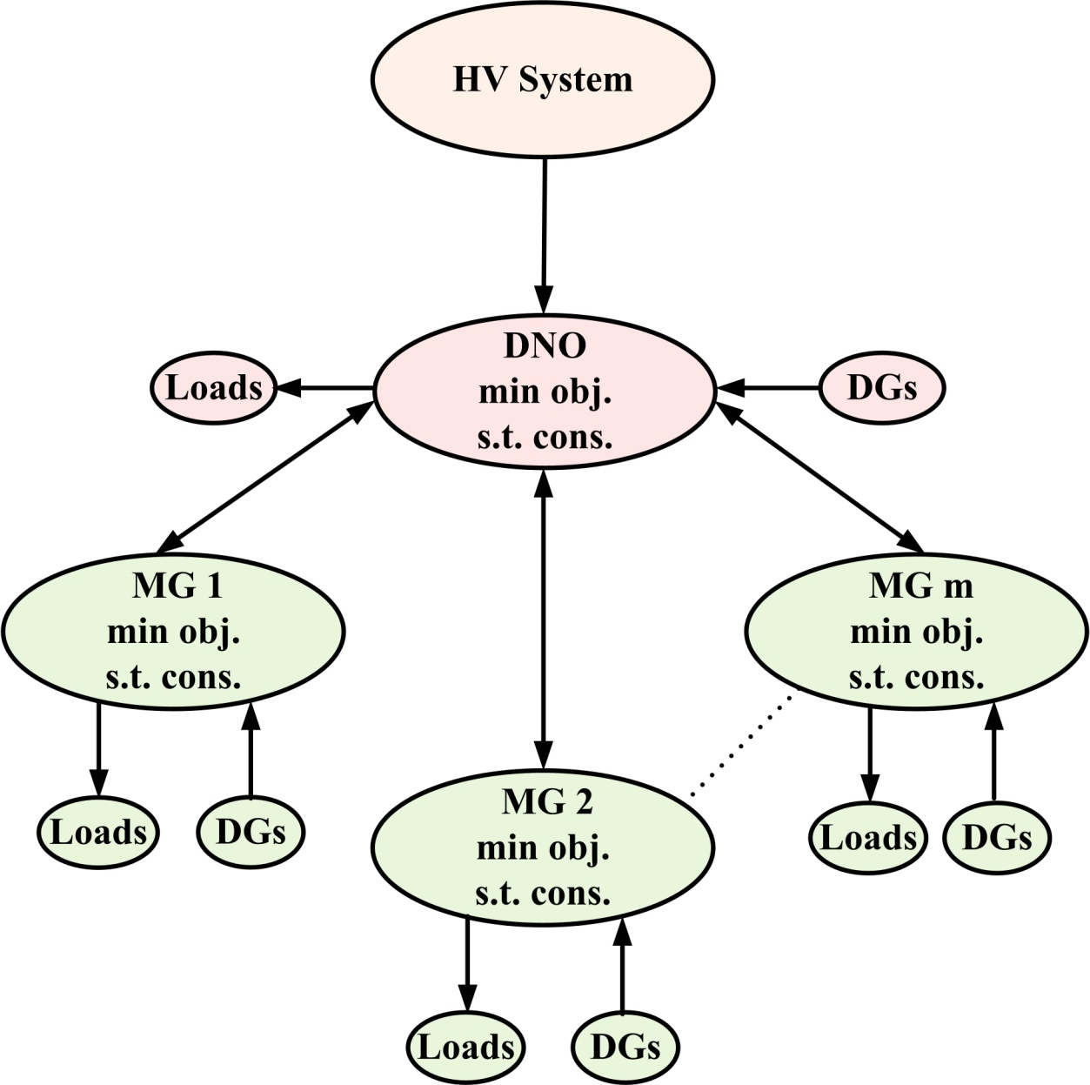
Centralized Coordination of Networked MGs
Each entity:
Min (operation costs-revenues)
s.t.
power flow constraints
voltage constraints
DG capacity constraints
KKT
Min (objective function of distribution network operator)
s.t.
constraints of DNO
complementarity constraints of ALL MGs
Fig. 6 Interactions between DNO and multiple MGs [7]
[7] Z. Wang, B. Chen, J. Wang, M. Begovic, and C. Chen, "Coordinated Energy Management of Networked Microgrids in Distribution Systems," IEEE Transactions on Smart Grid, vol. 6, no. 1, pp. 45-53, January 2015.

Slide 23
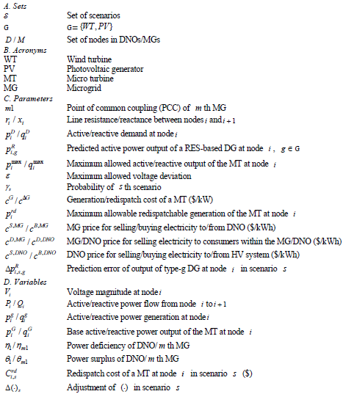
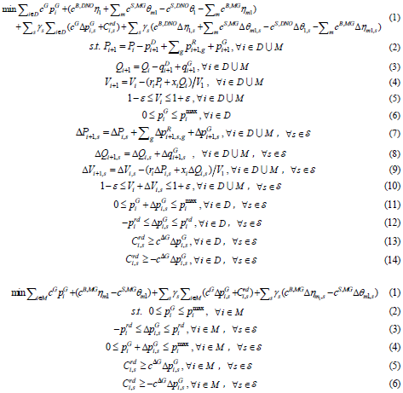
Coordinated Energy Management of Networked MGs
Power flow & voltage
MT
Second stage
DNO
MG

Slide 24
Coordinated Energy Management of Networked MGs
Each entity has min (operation costs-revenues)
s.t.
power flow constraints
voltage constraints
generator capacity constraints
KKT
Scenario generation by Monte-Carlo simulations
Min (objective function of DNO)
s.t.
constraints of DNO
complementarity constraints of ALL microgrids
Scenario reduction by simultaneous backward reduction method

Slide 25
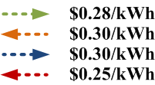
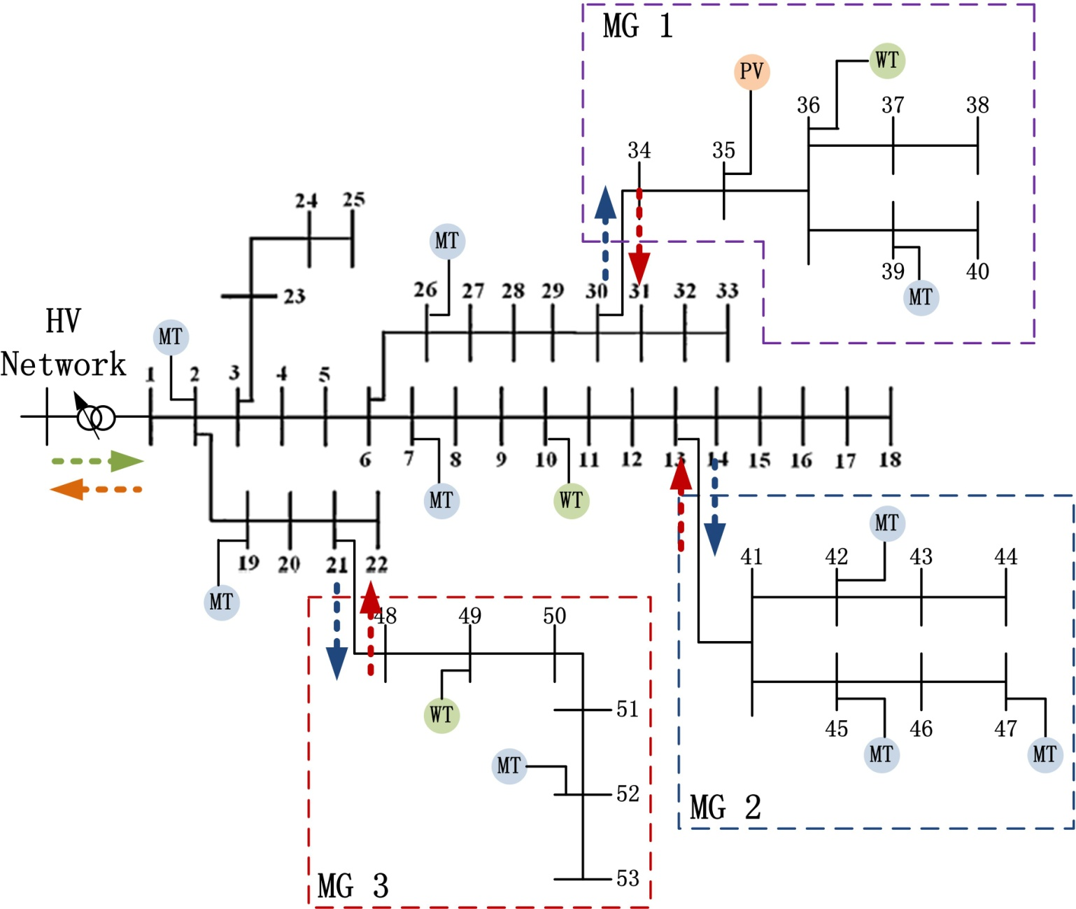
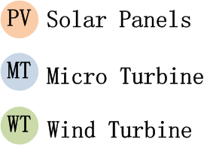
Coordinated Energy Management of Networked MGs
Electricity price
MG Loads: $0.20/kWh
DNO Loads: $0.30/kWh
MT generation cost: $0.10/kWh
MT redispatch cost: $0.15/kWh

Slide 26
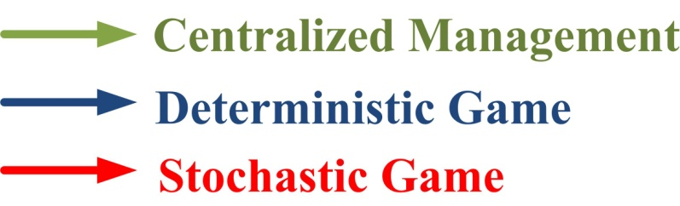
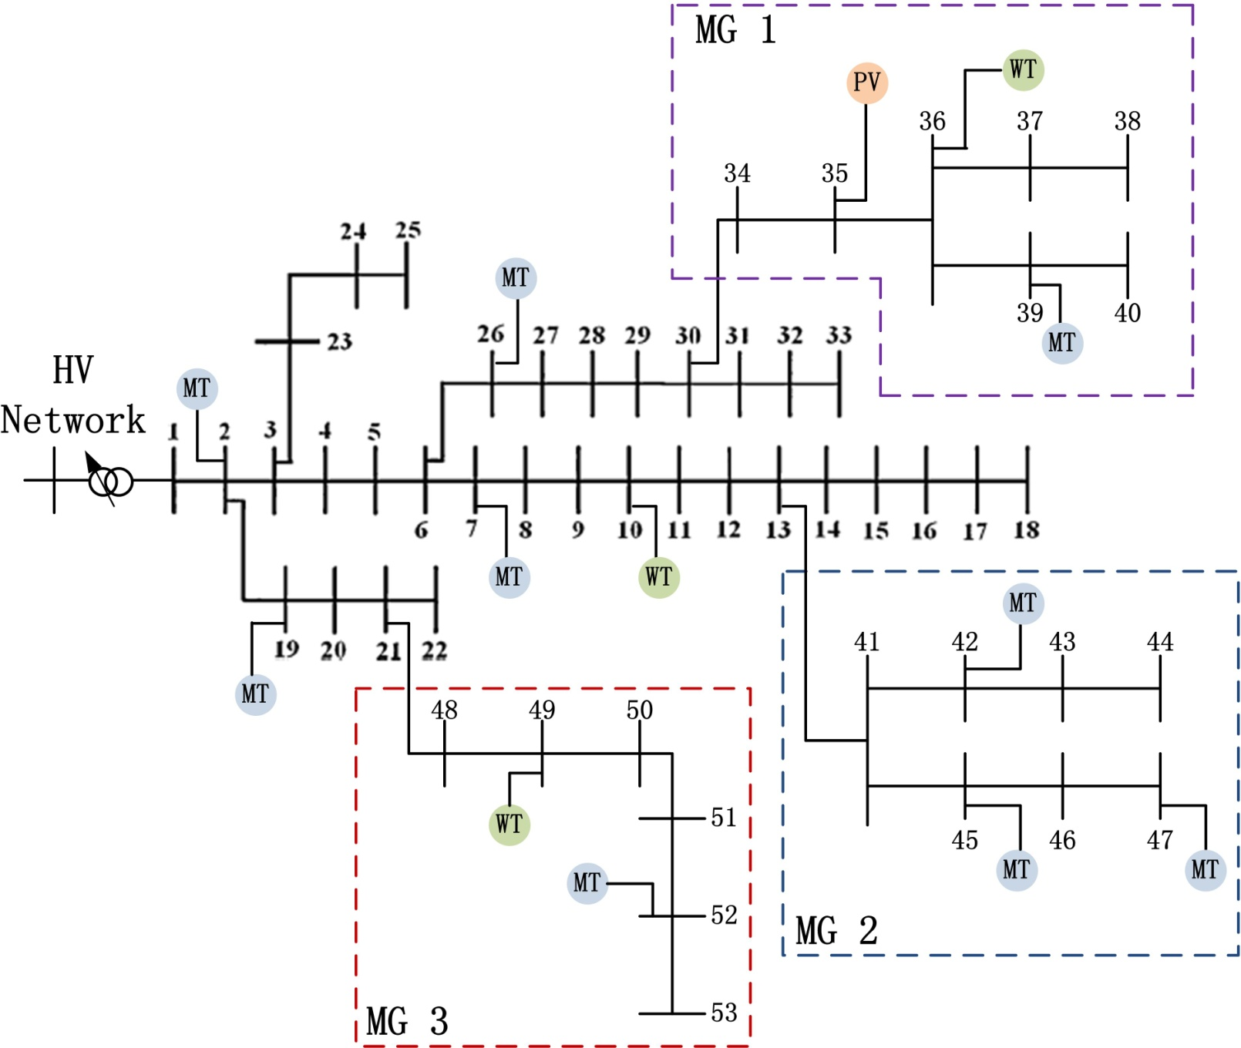
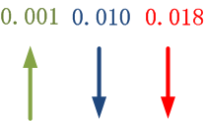


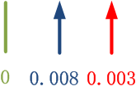
Coordinated Energy Management of Networked MGs

Slide 27
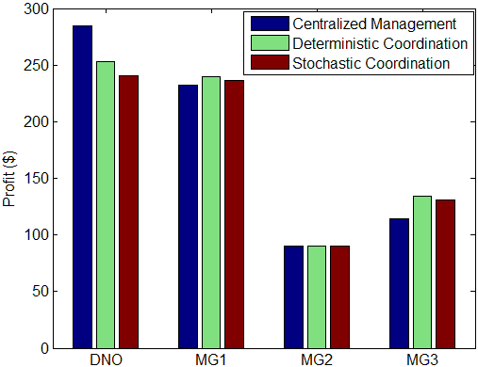
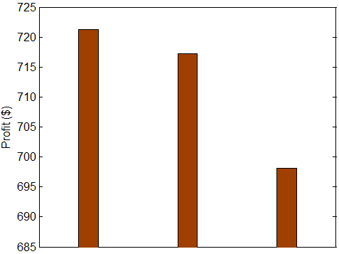
Coordinated Energy Management of Networked MGs
Profits of Each Entity
Total Profit of All Entities
Centralized Management
Deterministic Coordination
Stochastic Coordination

Slide 28
Decentralized Coordination of Networked MGs
Problem statement: in previous slides, we introduced our work on centralized coordination of networked MGs. Here the problem that we want to solve is to coordinate the operation of MGs and distribution systems in a completely decentralized fashion.
Proposed solution: A decentralized bi-level stochastic optimization algorithm that offers autonomy to each entity to optimize its own objectives subject to an entity-specific set of constraints.
The algorithm has two levels:
  The first level is to solve the optimization problem of each entity and conduct negotiations based on the current penalty factor until no further negotiations can be achieved.
  The second level is to update the penalty functions representing the mutual impacts between different entities until the optimal coordinated operation point is found.
Fig. 7 Distribution system with networked MGs [8]
[8] Z. Wang, B. Chen, J. Wang, and J. Kim, "Decentralized Energy Management System for Networked Microgrids in Grid-connected and Islanded Modes," IEEE Transactions on Smart Grid, vol. 7, no. 2, pp. 1097-1105, March 2016.

Slide 29
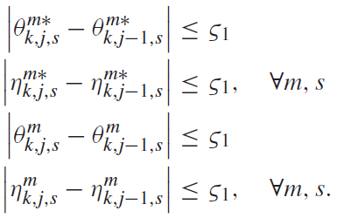

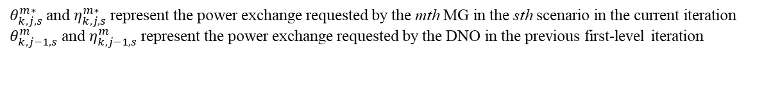
Decentralized Coordination of Networked MGs
Check convergence within entities
Power exchange requested by individual MGs
Power exchange requested by DNO
Check convergence between MGs and DNO
$θ_{k,j,s}^{m∗}$ and $η_{k,j,s}^{m∗}$ represent the power exchange requested by the mth MG in the sth scenario in the current iteration
$θ_{k,j−1,s}^{m}$ and $η_{k,j−1,s}^{m}$ represent the power exchange requested by the DNO in the previous first-level iteration

Slide 30
Decentralized Coordination of Networked MGs
A test distribution system with three networked MGs
Consider uncertainties of wind turbine (WT) generation, solar PV (PV) generation and load demand
Consider controllable micro-turbines (MT)

Slide 31
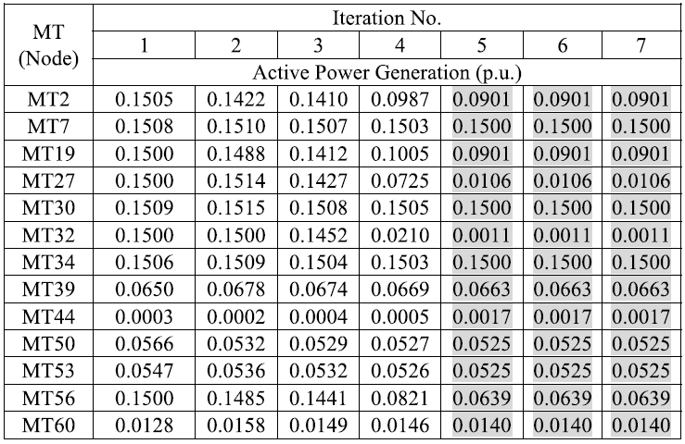
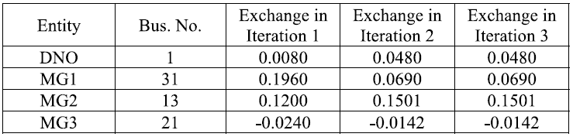
Decentralized Coordination of Networked MGs
Tab.3 Convergence of micro-turbine dispatches
Tab.2 Convergence of power exchange between distribution network operator (DNO) and MGs

Slide 32
Decentralized Coordination of Networked MGs
Fig. 8 Convergence of power exchange between distribution network operator (DNO) and MGs
Fig. 9 Highest and lowest voltage levels in individual MGs

Slide 33
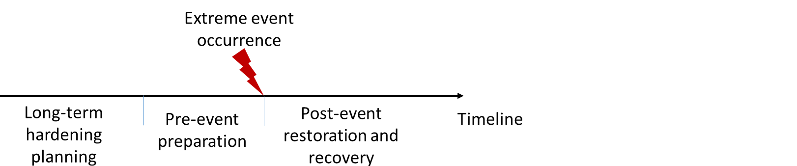
Scope of Power System Resilience Research
Aim: efficient post-event restoration
Proposed resilience strategies:
Microgrid formation
Divide the fault impacted area into several microgrids, restoring as much load as possible
Networked microgrid operation
The operation of networked microgrid in emergency situation
Repair crew dispatch
Crews are dispatched to repair the damaged components
Notes:
Our work tackles the issue in the post-event stage.

Slide 34
Restoration with Dynamic Microgrid Formation
Problem statement:
Propose a self-healing strategy to sectionalize the on-outage portion of a distribution system into self-supplied networked microgrids
A portion of larger distribution system
Decouple itself from main grid when the latter is under duress
Maintain the supply-demand balance for extended times
Can reattach itself to main grid after normal operation is resumed
Why to sectionalize?
Reduce time of restoration
Maintain power supply to critical loads using local capacity
Prevent possible cascading faults and cascading inverter trips
Challenges?
Dynamic nature of formation and dissolution considering uncertainties of renewable generations and loads
[8] Z. Wang and J. Wang, "Self-healing Resilient Distribution Systems based on Sectionalization into Microgrids," IEEE Transactions on Power Systems, vol. 30, no. 6, pp.3139-3149, November 2015.

Slide 35
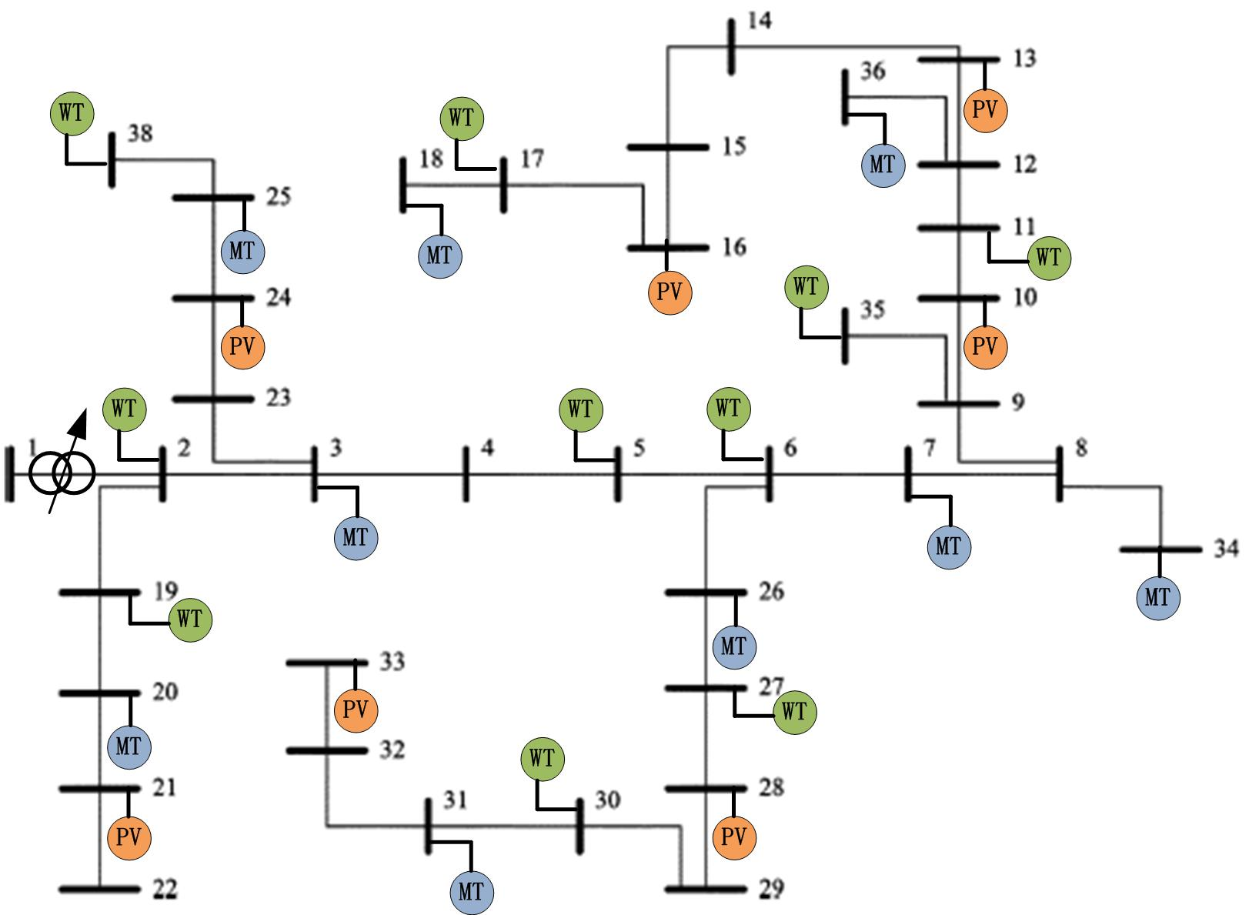
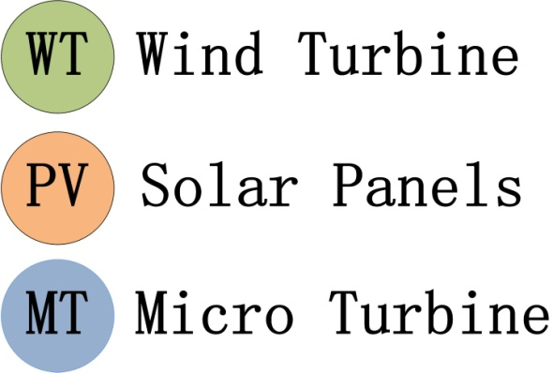
Restoration with Dynamic Microgrid Formation
Normal Operation
Self-healing Operation

Slide 36
Restoration with Dynamic MG Formation
Static MGs vs. dynamic MGs
A distribution grid can be automatically divided into several autonomous MGs surrounding local energy resources in response to power outage in the system. The configuration of these MGs can be changed dynamically.
Static MGs | Dynamic MGs
Static electric boundaries and connection point with external system | Dynamic electric boundaries and connection point with external system
Energy resources and managed in a static group | Energy resources need to be grouped dynamically
Operation as a single entity | Coordinated operation is required

Slide 37

Restoration with Dynamic MG Formation
Objective function: maximize weighted load picked up
Constraints for MGs Formation in MILP
  1) Node clustering constraints
  2) MG connectivity constraints. For a radial (tree) distribution network, each microgrid can be viewed as a subtree network with the root node being the node where the DG is installed.
  3) MG branch-node constraints. Each node/line must belong to a certain MG
  4) MG load pickup constraints
  5) MG operation constraints: Linearized DistFlow model
  6) Distribution system condition constraints

Slide 38
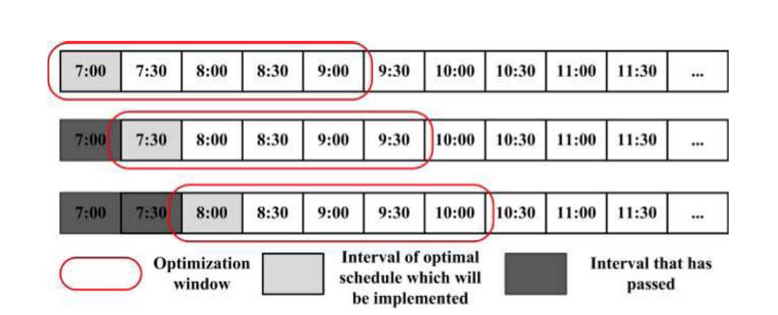
Restoration with Dynamic MG Formation
The on-outage area will be optimally sectionalized into networked self-adequate MGs which can autonomously provide reliable power supply to a maximum number of affected customers.
An optimization problem is formulated and solved to obtain optimal decisions over the optimization window. However, only the decision for the first time interval in the window is implemented in practice. The solutions for other time intervals will be discarded. The above process is repeated.
Fig. 10 Demonstration of rolling-horizon optimization

Slide 39
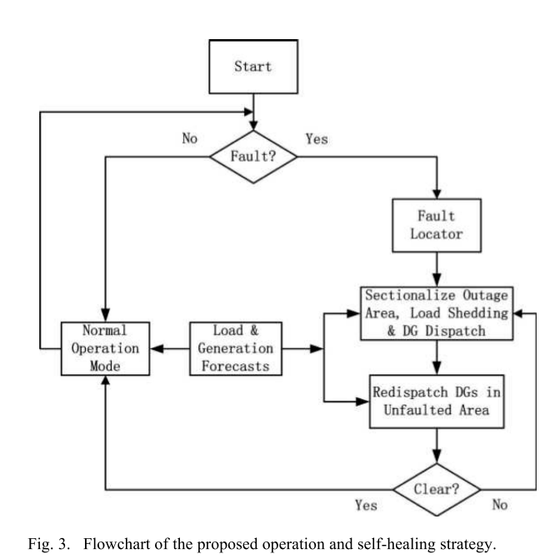
Restoration with Dynamic MG Formation
A rolling-horizon optimization method is used to schedule the outputs of dispatchable DGs based on forecasts.
In the self-healing mode, the on-outage portion of the distribution system will be optimally sectionalized into networked self-supplied MGs so as to provide reliable power supply to the maximum loads continuously.
In order to take into account the uncertainties of DG outputs and load consumptions, we formulate the problems as a stochastic program.
Fig. 11 Flowchart of the proposed operation and self-healing strategy [9]
[9] Z. Wang and J. Wang, "Self-healing Resilient Distribution Systems based on Sectionalization into Microgrids," IEEE Transactions on Power Systems, vol. 30, no. 6, pp.3139-3149, November 2015.

Slide 40
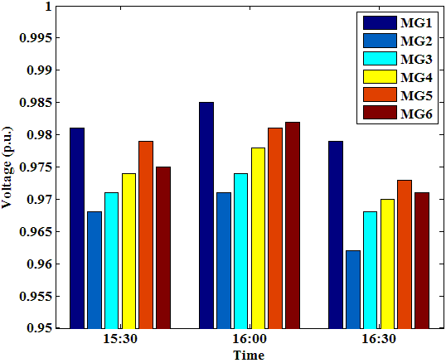
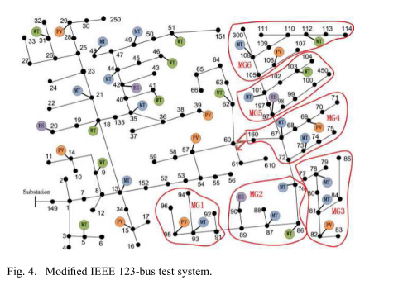
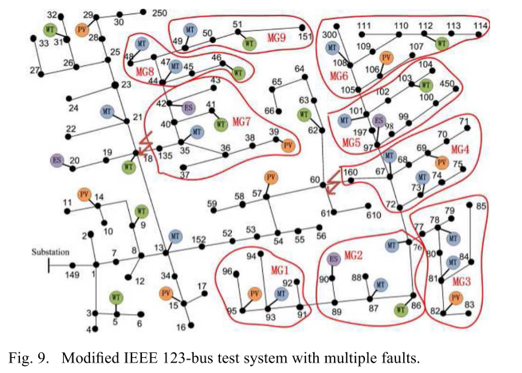
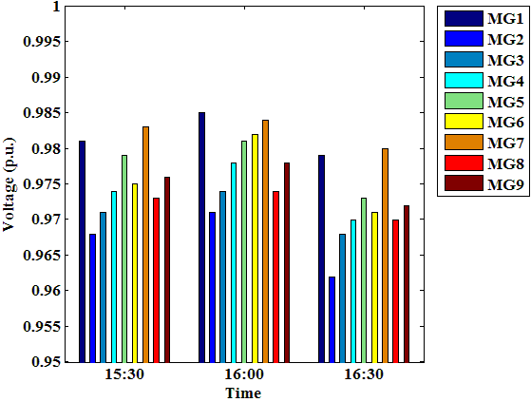
Restoration with Dynamic MG Formation
Self-Healing Mode for a Single Fault
Self-Healing Mode for Multiple Faults

Slide 41
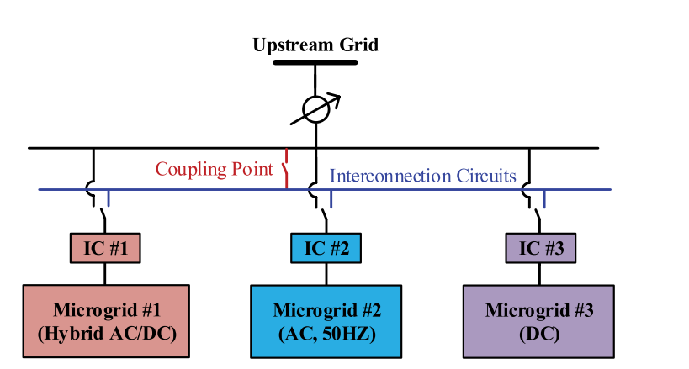
Networked MGs for Self-Healing Power Systems
Concept: A power distribution system can host a number of MGs that are networked to form a MG cluster.
Feature: Networked MGs operate cooperatively by sharing critical DER resources in order to overcome potential power deficiencies in MG clusters.
Top down restoration strategy
Bottom up restoration strategy
Fig. 12 Configuration of networked MGs

Slide 42
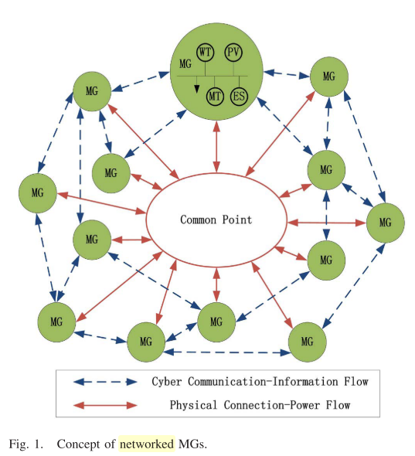
Networked MGs for Self-Healing Power Systems
The networked MGs are connected by a physical common bus and a designed two-layer cyber communication network.
In the self- healing mode, the local generation capacities of other MGs can be used to support the on-emergency portion of the system.
A consensus algorithm is used to distribute portions of the desired power support to each individual MG in a decentralized way.
Fig. 5 Concept of networked MGs [6]
[6] Z. Wang, B. Chen, J. Wang, and C. Chen, "Networked Microgrids for Self-healing Power Systems," IEEE Transactions on Smart Grid, vol. 7, no. 1, pp. 310-319, January 2016.

Slide 43


Networked MGs for Self-Healing Power Systems
Normal operation
Self-healing operation
The objective function minimizes the operation costs and generation-demand mismatch of the nth MG.
The operation objective is to make the power exchange with the common point approach μ as closely as possible.
Constraints:
Power balance constraints, ramp up/down constraints, etc.

Slide 44
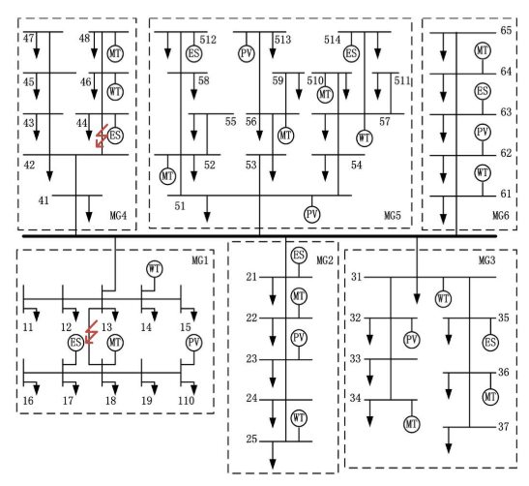
Networked MGs for Self-Healing Power Systems
Case study:
It is assumed that the six MGs are connected via a ring cyber network.
Each MG starts the iteration with its own total generation, and exchanges information with its neighboring MGs in the ring-connected cyber network.
The algorithm converges to the same value 5.963 MW, which is the averaged generation of all normally-operating MGs, in 14 iterations.
a single fault happens on the line sections 13–18 in MG1 at 18:00
Fig. 13 Test system with six networked MGs [6]
[6] Z. Wang, B. Chen, J. Wang, and C. Chen, "Networked Microgrids for Self-healing Power Systems," IEEE Transactions on Smart Grid, vol. 7, no. 1, pp. 310-319, January 2016.

Slide 45
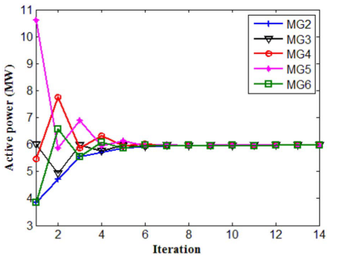
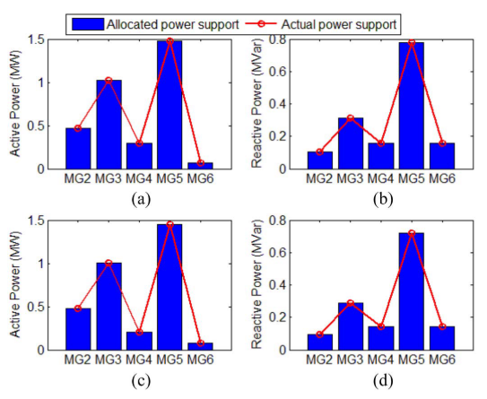
Networked MGs for Self-Healing Power Systems
Fig. 14 Iteration of total active power output of DGs in all normally-operation MGs at 18:00
Fig. 15 Allocated power support request and actual power support of each MG in Case 2. (a) and (b) Active and reactive power support at 18:00, respectively. (c) and (d) Active and reactive power support at 19:00, respectively.

Slide 46
Literature Review
A wide range of methods have been applied to solve optimal power management problem of networked MGs:
Centralized decision models
Distributed optimization methods
Heuristic techniques
Model-based method
Solve a large-scale optimization problem
Need complete information of MG physical models
Not adaptive to system parameter changes (such as, fuel price for diesel generators)
Need a method to address above challenges
Notes:
1. A wide range of methods have been applied in the literature with the aim of economic operation of the networked MGs, for example…
2. ALL above methods can be concluded as Model-based method, which means the decision agents depend on detailed physical models of MGs.
3. Challenges
4. New method

Slide 47
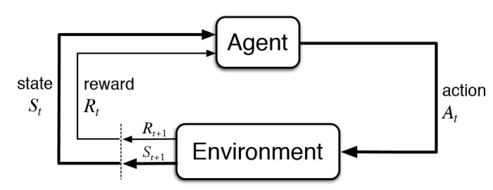
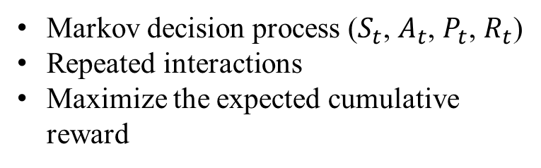
Solution
Reinforcement Learning (RL)
Power management of Networked MGs
Markov decision process ($S_{t}$, $A_{t}$, $P_{t}$, $R_{t}$)
Repeated interactions
Maximize the expected cumulative reward
Agent can solve the problem with incomplete information of Environment
Computational time (After the model is well trained)
Adaptability
Fig. 16 Concept of RL [10]
[10] R. S. Sutton and A. G. Barto, “Reinforcement Learning: An Introduction”, The MIT Press, London, England, 2017.
Notes:
1. Before I explain why we propose RL to solve power management problem of networked MGs.
2.（Move to the figure） It is a markov decision process, agent will observe state from environment and take actions with policies (possibility), then the environment will receive the action and feedback the reward to agent. There are repeated interactions between agents and environment to maximize the expected cumulative reward.
3. The advantages of using RL here.

Slide 48
Cooperative business model
To ensure the long-term sustainability and encourage economic development in rural communities, the feasibility of cooperative business models for rural system electrification was analyzed in literatures.
It has been shown that a non-profit cooperative can act as an intermediary agent between the rural MGs and the wholesale market.
  The power is exchanged between the MGs and the cooperative at a retail rate, and the revenue from electricity sales in the wholesale market is returned to MGs.
  The retail energy pricing program can be used to influence the MGs’ behavior based on the availability of resources.
This paper was motivated to address power management of several privately-owned MGs that are members of a cooperative, under data privacy and ownership constraints. The data access constraint can hinder the feasibility of cooperative power management.
To address this issue, we have proposed a reinforcement learning (RL)-based method that enables optimal resource allocation within the cooperative model, while maintaining the data ownership of the participating MGs.
Notes:
As shown in this fig, at the level I, a utility agent will use the RL-based method to determine the locational price signals as actions with incomplete information on the MGs. The proposed RL method enables the utility agent to adapt to changing system conditions and learn from previous experiences, while respecting the data privacy of the MGs, because it only needs to observe the environment states as aggregate level load and solar information.
At the level II, the MGs receive the price signals to dispatch their generation/storage assets individually over look-ahead decision time window, while considering power flow constraints.

Slide 49
Contributions
In summary, the main contributions of [11] can be listed as follows:
The proposed power management system can handle the current limitations raised from data privacy and ownership in the cooperative setting. Considering the model-free nature of our RL-based method, the data privacy of MGs and the data confidentiality of customers are maintained. The power management problem is solved with access to only minimal and aggregated data.
The proposed RL solver is faster than conventional optimization solvers since the learned state-action value function acts similar to a memory that recalls from the cooperative agent’s past experiences to estimate new optimal solutions. This is done by updating the state values at each decision window and without re-solving the decision problem.
The RL framework is trained using a regularized recursive least square methodology with a forgetting factor, which enables the decision model to be adaptive to changes in system parameters which are excluded from the cooperative agent’s state set.
[11] Q. Zhang, K. Dehghanpour, Z. Wang, Q. Huang, “A Learning based Power Management for Networked Under Incomplete Information”, in IEEE Trans. Smart Grid, Early Access.
Notes:
1. Before I explain why we propose RL to solve power management problem of networked MGs.
2.（Move to the figure） It is a markov decision process, agent will observe state from environment and take actions with policies (possibility), then the environment will receive the action and feedback the reward to agent. There are repeated interactions between agents and environment to maximize the expected cumulative reward.
3. The advantages of using RL here.

Slide 50
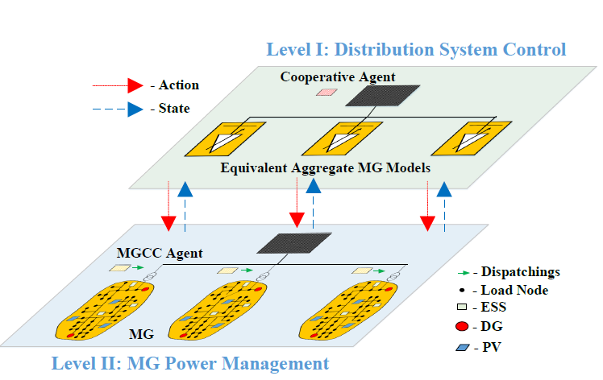
Bi-level RL-based Networked MGs Power Management
Level I - RL-based Distribution System Control:
The cooperative agent employs an adaptive model-free RL method.
Develop a regularized recursive least square function approximation methodology.
Find the optimal retail price signals for the MGs based on the latest system states.
Level II - MG Power Management:
The MGCC agents receive the price signal for a look-ahead moving decision window.
Each MGCC agent solves a Mixed Integer Nonlinear Programming (MINLP) to dispatch their local generation/ storage assets to maximize their revenue in the price-based environment, subject to full AC power flow constraints.
Fig. 17 The architecture of the bi-level networked MGs power management
[11] Q. Zhang, K. Dehghanpour, Z. Wang, Q. Huang, “A Learning based Power Management for Networked Under Incomplete Information”, in IEEE Trans. Smart Grid, Early Access.
Notes:
As shown in this fig, at the level I, a utility agent will use the RL-based method to determine the locational price signals as actions with incomplete information on the MGs. The proposed RL method enables the utility agent to adapt to changing system conditions and learn from previous experiences, while respecting the data privacy of the MGs, because it only needs to observe the environment states as aggregate level load and solar information.
At the level II, the MGs receive the price signals to dispatch their generation/storage assets individually over look-ahead decision time window, while considering power flow constraints.

Slide 51
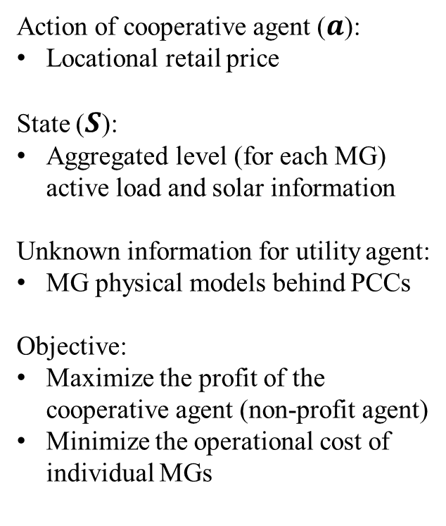
Bi-level RL-based Networked MGs Power Management
Action of cooperative agent ($a$):
Locational retail price
State ($S$):
Aggregated level (for each MG) active load and solar information
Unknown information for utility agent:
MG physical models behind PCCs
Objective:
Maximize the profit of the cooperative agent (non-profit agent)
Minimize the operational cost of individual MGs
Fig. 17 The architecture of the bi-level networked MGs power management
Notes:
As shown in this fig, at the level I, a utility agent will use the RL-based method to determine the locational price signals as actions with incomplete information on the MGs. The proposed RL method enables the utility agent to adapt to changing system conditions and learn from previous experiences, while respecting the data privacy of the MGs, because it only needs to observe the environment states as aggregate level load and solar information.
At the level II, the MGs receive the price signals to dispatch their generation/storage assets individually over look-ahead decision time window, while considering power flow constraints.

Slide 52
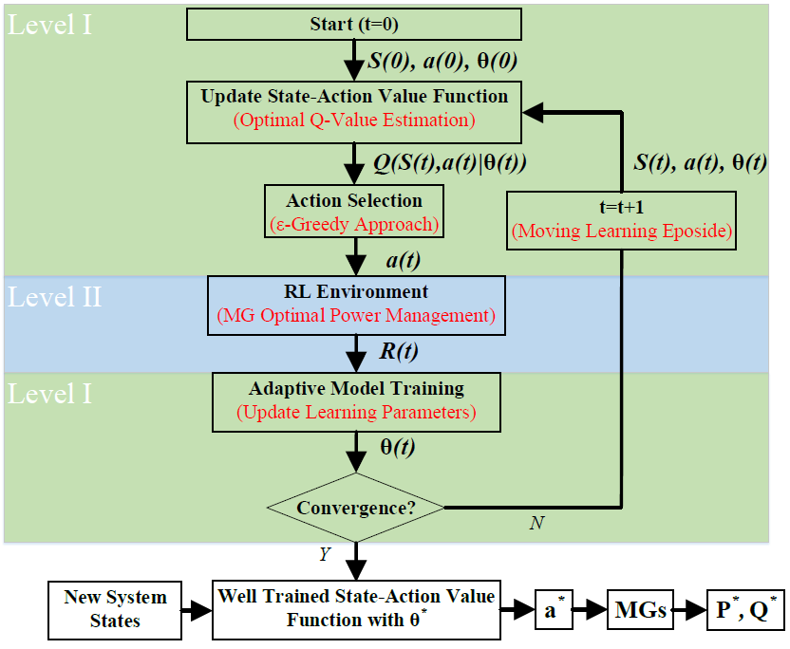
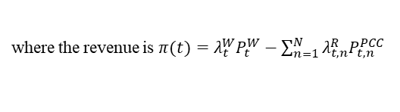
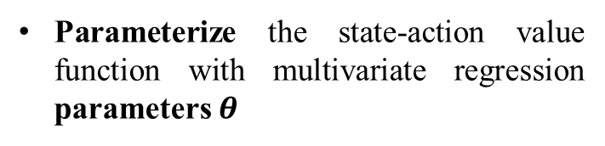
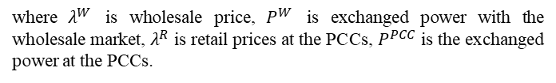


Level I: Adaptive RL-based Distribution System Control
Maximize the reward function (R-function)
s.t. MGs response
$$R\left(t\right)=\sum_{t^{′}=0}^{T−1}{γ^{t^{′}}\left(λ_{t+t^{′}}^{W}P_{t+t^{′}}^{W}−\sum_{n=1}^{N}{λ_{t+t^{′},n}^{R}P_{t{+t}^{′},n}^{PCC}}\right)}$$
where $λ^{W}$ is wholesale price, $P^{W}$ is exchanged power with the wholesale market, $λ^{R}$ is retail prices at the PCCs, $P^{PCC}$ is the exchanged power at the PCCs.
The state-action value function (Q-function)
Expected cumulative reward
$$Q_{t}\left(S,a\right)=E\left\{\sum_{t^{′}=0}^{T−1}{γ^{t^{′}}π\left(t+t^{′}\right)|S\left(t\right)=S,a\left(t\right)=a}\right\}$$
where the revenue is $π(t)=λ_{t}^{W}P_{t}^{W}−\sum_{n=1}^{N}{λ_{t,n}^{R}P_{t,n}^{PCC}}$
Parameterize the state-action value function with multivariate regression parameters $θ$
Fig. 18 Flowchart of the proposed RL-based method
$$Q_{t}\left(S,a\right)≈{\hat{Q}}_{t}\left(S,a|θ\right)=Q_{S∙a}\left(t|θ\right)+Q_{S}\left(t|θ\right)+Q_{a}\left(t|θ\right)$$
Notes:
1. As I said before, we want to maximize the Reward function (discount factor that defines the agent’s preference for the immediate reward), but we do not know the MGs response. Thus we cannot solve this problem, so we introduce a state-action value function to track reward.
2. Q function here is the expected accumulated reward. The expectation operator E is calculated with respect to the future expected state-action pairs, in this case are in turn functions of the solar-load uncertain powers.
3. The goal of RL is to learn an optimal state-action value function, Q, so we have parameterized the Q function with a multivariate polynomial regression approximation model with parameters Thetas.
4. As shown in this fig, we have MG power management as environment, which will receive action from utility agent and feedback Reward.
5. There are two important parts in the utility agent decision model, action selection and update state-action value function.
P_W is the exchanged power with the wholesale market, where PW>0 represents power export to the wholesale market.
L_W is the wholesale power price
Pi is the immediate reward
P_PCC is the active power transfer between grid and the nth MG through the PCC, P_PCC>0 represents MG power export to the grid.

Slide 53
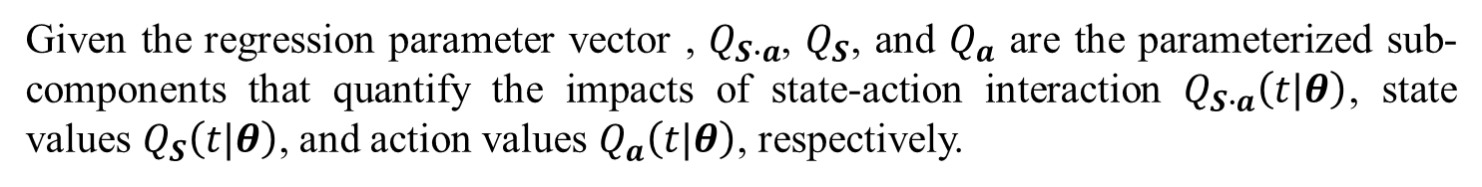
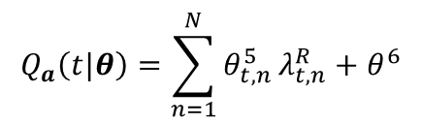
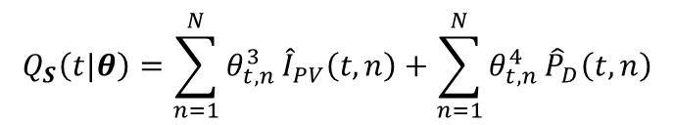
Level I: Multivariate polynomial regression model
Given the regression parameter vector , $Q_{S∙a}$, $Q_{S}$, and $Q_{a}$ are the parameterized sub-components that quantify the impacts of state-action interaction $Q_{S∙a}\left(t|θ\right)$, state values $Q_{S}\left(t|θ\right)$, and action values $Q_{a}\left(t|θ\right)$, respectively.
$$Q_{t}\left(S,a\right)≈{\hat{Q}}_{t}\left(S,a|θ\right)=Q_{S∙a}\left(t|θ\right)+Q_{S}\left(t|θ\right)+Q_{a}\left(t|θ\right)$$
These regression sub-components in multivariate polynomial regression model are defined as follows:
$$Q_{S∙a}\left(t|θ\right)=\sum_{n=1}^{N}{θ_{t,n}^{1}}λ_{t,n}^{R}{\hat{I}}_{PV}\left(t,n\right)+\sum_{n=1}^{N}{θ_{t,n}^{2}}λ_{t,n}^{R}{\hat{P}}_{D}\left(t,n\right)$$
$$Q_{S}\left(t|θ\right)=\sum_{n=1}^{N}{θ_{t,n}^{3}}{\hat{I}}_{PV}\left(t,n\right)+\sum_{n=1}^{N}{θ_{t,n}^{4}}{\hat{P}}_{D}\left(t,n\right)$$
$$Q_{a}\left(t|θ\right)=\sum_{n=1}^{N}{θ_{t,n}^{5}}λ_{t,n}^{R}+θ^{6}$$
where ${\hat{I}}_{PV}$ and ${\hat{P}}_{D}$ are the system state vectors of solar irradiance and active load demand estimations.
Notes:
1. As I said before, we want to maximize the Reward function (discount factor that defines the agent’s preference for the immediate reward), but we do not know the MGs response. Thus we cannot solve this problem, so we introduce a state-action value function to track reward.
2. Q function here is the expected accumulated reward. The expectation operator E is calculated with respect to the future expected state-action pairs, in this case are in turn functions of the solar-load uncertain powers.
3. The goal of RL is to learn an optimal state-action value function, Q, so we have parameterized the Q function with a multivariate polynomial regression approximation model with parameters Thetas.
4. As shown in this fig, we have MG power management as environment, which will receive action from utility agent and feedback Reward.
5. There are two important parts in the utility agent decision model, action selection and update state-action value function.
P_W is the exchanged power with the wholesale market, where PW>0 represents power export to the wholesale market.
L_W is the wholesale power price
Pi is the immediate reward
P_PCC is the active power transfer between grid and the nth MG through the PCC, P_PCC>0 represents MG power export to the grid.

Slide 54


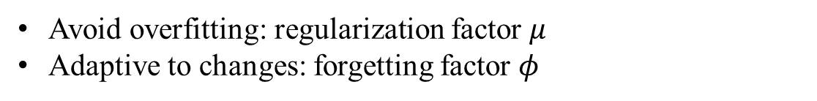


Level I: Learning Process
Action selection: $ϵ$-greedy method
$$a_{opt}\left(t^{′}\right)= arg\max_{a^{′}}{Q_{t^{′}}\left(S\left(t^{′}\right),a^{′}\right)}$$
$$a\left(t\right)=\left\{\begin{aligned}a_{opt}\left(t\right), &if r≥ε \\ λ_{t,i}^{R}\sim U\left\{ρ_{λ}\right\} , &if r<ε\end{aligned}\right.$$
$$0≤ε≪1$$
$$r\sim U\{[0,1]\}$$
Reduce the risk of sub-optimality
Promote continuous exploration of action space
Update $θ$: gradient descent approach and regularized recursive least squares algorithm
Learning rule :
$$θ \left(t+1\right)←θ\left(t\right)+δ\left\{R\left(t\right)−{\hat{Q}}_{t}\left(S,a|θ\right)\right\}∇_{θ}{\hat{Q}}_{t}\left(S,a|θ\right)$$
$$θ\left(t+1\right)←θ(t)+∆(t)x(t)\left\{R\left(t\right)−{\hat{Q}}_{t}\left(S,a|θ\right)\right\}$$
$$∆\left(t+1\right)←\hat{∆}\left(t+1\right){\left(I+μ\hat{∆}\left(t+1\right)\right)}^{−1}$$
$$\hat{∆}\left(t+1\right)←\frac{1}{1−φ}\left(∆\left(t\right)−\frac{∆\left(t\right)x(t)x^{T}(t)Δ(t)}{1+x^{T}(t)∆\left(t\right)x(t)}\right)$$
Avoid overfitting: regularization factor $μ$
Adaptive to changes: forgetting factor $φ$
Notes:
1. A critical aspect of action selection step is that the obtained optimal action is calculated based on the latest state-action value function, which is not accurate in the early stages in the training process.
2. Therefore, to reduce the risk of sub-optimality and to encourage the agent to explore the decision space, we use the eplison greedy method. The factor eplison is a small number. R is random number between 0 and 1. IF…there are two conditions
3. Ideally, we update station-action value function, so that the Q function can accurate predict the accumulated reward.
4. So we use a gradient descent approach to modify the parameters in the direction of improving the state-action value function.
5. The overfitting problem of Q function happens in RL. And the RL training process needs to be adaptive to enable utility agent to quickly conform the new system conditions
6. Therefore a regularized recursive least squares algorithm has been added here to update theta.
7. Mu is the regularization factor which is used for re-scaling the model covariance and act as a weight for penalizing the norm of parameter vector Theta
8. Forgetting factor enables the utility agent to “forget” its earlier experiences by assigning lower weights to the previously learned parameters
X represents the latest utility agent observation
Delta is is an auxiliary matrix mimicking the regression pseudo-inverse matrix

Slide 55





Level II: MGCC Agent Power Management
To simulate the environment, each MG receives the price signals as action from the utility to solve the constrained power management problem within a moving decision window.
$$\min_{x_{p},x_{q}}{\sum_{t}^{T+t}{\left(−λ_{t,n}^{R}P_{t,n}^{PCC}+λ_{i,t,n}^{F}F_{i,t,n}\right)}}$$
The objective minimize each MG’s total cost of operation.
s.t.
$$F_{i,t,n}=a_{f}{\left(P_{i,t,n}^{DG}\right)}^{2}+b_{f}P_{i,t,n}^{DG}+c_{f}$$
The fuel consumption of diesel generators (DGs) can be expressed as a quadratic polynomial function.
$$\left|P_{t,n}^{PCC}\right|≤P_{t,n}^{PCC,M}$$
$$\left|Q_{t,n}^{PCC}\right|≤Q_{t,n}^{PCC,M}$$
Power exchange limit between the MG and the upstream utility grid
$$0≤P_{i,t,n}^{DG}≤P_{i,t,n}^{DG,M}$$
$$0≤Q_{i,t,n}^{DG}≤Q_{i,t,n}^{DG,M}$$
$$\left|P_{i,t,n}^{DG}−P_{i,t−1,n}^{DG}\right|≤P_{i,n}^{DG,R}$$
DG active/reactive power output limits, and DG ramping constraint
$$P_{t,n}^{ij}=V_{t,n}^{i}\left(V_{t,n}^{i}G_{n}^{ij}−V_{t,n}^{j}\left(G_{n}^{ij}\cos\left(θ_{t,n}^{ij}\right)+B_{n}^{ij}\sin\left(θ_{t,n}^{ij}\right)\right)\right)$$
$$Q_{t,n}^{ij}=−V_{t,n}^{i}\left(V_{t,n}^{i}B_{n}^{ij}+V_{t,n}^{j}\left(G_{n}^{ij}\cos\left(θ_{t,n}^{ij}\right)−B_{n}^{ij}\sin\left(θ_{t,n}^{ij}\right)\right)\right)$$
$${\left(P_{t,n}^{ij}\right)}^{2}+{\left(Q_{t,n}^{ij}\right)}^{2}≤{\left(S_{t,n}^{ij,M}\right)}^{2}$$
Line active/reactive flow calculations, and line flow limit constraint
Notes:
1. At Level II, in order to simulate the environment response, each MG receives the price signals as action from the utility to solve the constrained optimal power management problem within a moving decision window individually
2. Since it is not our contribution, we can just quick review it.
3. Each MG has local diesel generators, ESS, PVs and a number of loads.
4. The objective minimize MG total operational cost. And we have constraints…

Slide 56



Level II: MGCC Agent Power Management
$$\sum_{i,j∈k}^{K}{P_{t,n}^{ij}}=\sum_{j,i∈k}^{K}{P_{t,n}^{ji}}−p_{i,t,n}$$
$$\sum_{i,j∈k}^{K}{Q_{t,n}^{ij}}=\sum_{j,i∈k}^{K}{Q_{t,n}^{ji}}−q_{i,t,n}$$
$$p_{i,t,n}=P_{i,t,n}^{D,e}−P_{i,t,n}^{DG}−P_{i,t,n}^{PV,e}+P_{i,t,n}^{Ch}−P_{i,t,n}^{Dis}$$
$$P_{i,t,n}^{D}=P_{i,t,n}^{D,e}−ε_{i,t,n}^{D}, P_{i,t,n}^{PV}=P_{i,t,n}^{PV,e}−ε_{i,t,n}^{PV}$$
$$q_{i,t,n}=Q_{i,t,n}^{D}−Q_{i,t,n}^{DG}−Q_{i,t,n}^{PV}+Q_{i,t,n}^{ESS}$$
Nodal active/reactive power balance constraints
$$V_{t,n}^{PCC}=V_{t,n}^{PCC,E}$$
$$V_{i,n}^{m}≤V_{i,t,n}≤V_{i,n}^{M}$$
$$\left|Q_{i,t,n}^{PV}\right|≤Q_{i,n}^{PV,M}$$
Nodal voltage constraints
PV reactive power output limit
$$E_{i,t,n}=E_{i,t−1,n}+∆t\left(P_{i,t,n}^{Ch}η_{Ch}−{P_{i,t,n}^{Dis}}/{η_{Dis}}\right)/E_{i,n}^{Cap}$$
$${E_{i,n}^{m}≤E}_{i,t,n}≤E_{i,n}^{M}$$
$$0≤P_{i,t,n}^{Ch}≤{μ_{i,t,n}^{Ch}P}_{i,n}^{Ch,M}$$
$$0≤P_{i,t,n}^{Dis}≤{μ_{i,t,n}^{Dis}P}_{i,n}^{Dis,M}$$
$${0≤μ}_{i,t,n}^{Ch}+μ_{i,t,n}^{Dis}≤1, μ_{i,t,n}^{Ch},μ_{i,t,n}^{Dis}∈\{0,1\}$$
ESS operational constraints

Slide 57

Level II: MGCC Agent Power Management
The steps of the interactive power flow solution are as follows:
Step I. Receive input signals from Level I: The MGs receive the retail price signals at the PCCs, $λ_{t,n}^{R}$, from the cooperative agent.
Step II. Solve individual MG optimal power management problem: Given $λ_{t,n}^{R}$ and the estimated voltage at PCC, the power management problem is solved independently by each MGCC, and the exchanged active and reactive powers at the PCCs are obtained for each MG.
Step III. Solve power flow problem over distribution system: Treating MGs as fixed PQ loads in the external distribution system, power flow is solved over the network connecting the MGs. The total substation exchanged power, $P_{t}^{W}$ , and voltage values at PCCs, $V_{t,n}^{PCC}$, are updated based on the power flow solution.
Step IV. Check convergence: Go back to Step III to update PQ values corresponding to each MG, until the changes in voltage values at MG PCCs are smaller than a threshold value $V_{Th}$.

Slide 58




Case Study
The case study has of four MGs (33-bus network and 13-bus network) in Fig. 19.
Tab. 4 presents all setting parameters for the proposed RL-based method.
Both load demands and PV generations data with 15-min time resolution are obtained from smart meters to provide realistic numerical experiments in Fig. 20a and Fig. 20b.
The wholesale market prices used in the numerical case study have been shown in Fig. 20c.
Fig. 20 Input data for the case study
Fig. 19 Test system under study
Tab. 4 Test system under study
Notes:
1. The case study consists of four MGs as shown below (33-bus network and 13-bus network).
2. Both load demands and PV generations data with 15 minutes time resolution are obtained from smart meters to provide realistic numerical experiments.
3. All setting parameters for the proposed RL-based method are shown in this table.
To represent a realistic model, we simulated an unbalanced system, where the loads and generators are almost uniformly distributed across phases. Note that the proposed model-free power management technique applies to both balanced and unbalanced systems

Slide 59


Numerical Results
Fig. 21 Optimal locational retail price signals
Fig. 20 Input data for the case study
Fig. 21 and Fig. 22 show the correlations and mutual impacts between the optimal retail price signals from Level I and optimal MGs’ behaviors from Level II, respectively.
As the wholesale price increases, the cooperative agent increases the retail prices to encourage the MGs to produce more power to reduce the costs of power purchase from the wholesale market.
Fig. 22 Optimal power transferred through PCC of MGs
Notes:
1. The optimal locational price and power exchanges for the MGs are shown. It can be observed that, most of the time, the utility exports power to the MGs to maintain power balance in the system.
2. It is because, in this case, MGs cannot provide their local demand consumption by their own local generation and have to purchase power from the utility. This provides the utility with the opportunity to raise retail prices to gain profit.
3. In this table, the total social welfare is defined as the summation of the utility accumulated reward and the operational cost of all the MGs.
4. Ideally both of the solvers should output the global optimal solution to the problem. As can be seen, the difference between the solutions obtained by the centralized solver with complete system information, and the proposed RL method under incomplete information is less than 0.5%.
5. Note that while the initial RL training stage can be time-consuming, the decision time is much smaller than the centralized optimization method.
6. It is because the proposed RL-based method is able to receive continual updates in the training process. After training, the RL framework can give a solution WITH NEW STATE in real-time . It does not need to solve a large-scale optimization problem.

Slide 60

Benefits of RL-based Method: comparison
A numerical comparison between a centralized solver (complete information) versus the proposed RL-based method (incomplete information).
Tab. 5 Comparison with A Centralized Optimization Method
As can be seen in Tab.5:
  The difference between the solutions obtained by the centralized solver and the proposed RL is less than 0.5% of the total achieved welfare.
  The decision time of the proposed RL-based method is much smaller than that of a centralized optimization method.
  The proposed method maintains the privacy of MGs physical model.
Notes:
1. In this table, the total social welfare is defined as the summation of the utility accumulated reward and the operational cost of all the MGs.
2. Ideally both of the solvers should output the global optimal solution to the problem. As can be seen, the difference between the solutions obtained by the centralized solver with complete system information, and the proposed RL method under incomplete information is less than 0.5%.
3. Note that while the initial RL training stage can be time-consuming, the decision time is much smaller than the centralized optimization method.
4. It is because the proposed RL-based method is able to receive continual updates in the training process. After training, the RL framework can give a solution WITH NEW STATE in real-time . It does not need to solve a large-scale optimization problem.

Slide 61



Benefits of RL-based Method: memory effect
To demonstrate the memory effect of RL-based method, we have performed numerical experiments in which the trained state-action value functions of three different decision window have been used for new decision window without re-training.
Fig. 23 Verifying the memory effect of the proposed Q-function and $θ^{∗}$
Therefore, it shows that the trained Q-function and $θ^{∗}$ having general applicability for different scenarios (with similar state type).
Notes:
In each scenario the RL training is performed for one of the decision windows from random initial conditions, while the updated aggregate MG solar generation and load demand from that decision window are simply inserted into the learned state-action value functions obtained from the other three decision windows.
As can be seen, for all scenarios the optimal solutions are close to each other and almost identical.
This shows that the state-action value function learned from other decision windows can be used reliably in new situations using updated state information.

Slide 62
Benefits of RL-based Method
Therefore, the RL-based method has two fundamental advantages over centralized optimization method:
RL is model-free
unlike centralized optimization approaches, the proposed RL-based method does not require detailed private knowledge of MG systems to reach the optimal solution.
RL is much faster compared to centralized solvers
since the trained state-action value function (parameterized Q-function), which acts similar to a memory, is able to leverage the cooperative agents past experiences to obtain new optimal solutions by generalizing to new unseen states.

Slide 63

Performance of the proposed reward function approximation
To verify the functionality of the RL framework, the estimated reward (value of parameterized Q-function) obtained from the multiple linear regression is compared with the actual reward (value of R-function) at each episode, as shown in Fig. 24.
At the earlier stages of the learning process, the difference between the estimated reward and the real reward is relatively high.
However, as the number of episodes increases, this difference drops to within an acceptable range.
Fig. 24 Estimated utility reward VS actual received reward
The results imply that the cooperative agent is able to accurately estimate the response of MGs to control actions.

Slide 64

Adaptive RL Results
To test the adaptability of the learning framework against changes in parameters (non-state parameters).
When episode=250, the DG fuel price is doubled.
The proposed RL-based method (with forgetting factor) can track the actual reward signal with the sudden parameter changes.
While, the conventional RL-based (without forgetting factor) method shows slow adaptation to changes in parameters.
For this case, our proposed RL-based method is able to achieve 25% overall improvement in the convergence constant over conventional RL method.
Fig. 25 Adaptability of the proposed RL-based method
Notes:
We have results to verify the functionality and adaptability of the RL-based method
1. At the earlier stages of the learning process, the difference between the estimated utility reward and the real reward is relatively high. However, as the number of episodes increases, this difference drops to within an acceptable range (less than 2%), which implies that the utility agent is able to accurately predict the response of MGs
2. We assume a scenario. At t = 1500, the DG fuel price is doubled. The reward estimation Mean Absolute Percentage Error (MAPE) is shown here. As can be seen, when the sudden change happens, the learning error percentage temporarily jumps to a very high value since the utility agent has a new unknown environment, and also because the fuel price is not included within the agent’s Markov decision process, as system state. However, as the learning process with forgetting proceeds, the error percentage drops to within acceptable range once again. The same thing can be observed from this fig, utility agent can still track the reward after the changes.
3. The impact of forgetting factor on the convergence of the RL framework is demonstrated. As the forgetting factor increases from 0.01 to 0.1 the convergence speed of the RL framework has been improved. It is because the forgetting factor controls the rate of adaptiveness to new conditions. However, a trade-off exists between the rate of convergence and the accuracy of the solution. As observed in this figure, higher forgetting factors also lead to higher variances in the estimation error.

Slide 65

Adaptive RL Results
In Fig. 26, the impact of forgetting factor on the convergence of the RL framework is demonstrated.
As the forgetting factor increases from 0.01 to 0.1, the convergence speed of the RL framework has been improved.
However, a tradeoff exists between the rate of convergence and the accuracy of the solution.
Higher forgetting factors also lead to higher variances in the estimation error signal.
Fig. 26 Impact of forgetting factor on RL convergence

Slide 66
Conclusion
To summarize, the proposed decision model shows better adaptability, solution quality, and computational time compared to conventional centralized optimization methods.
  Using the proposed decision method, a cooperative agent is able to accurately track the behavior of multiple networked MGs under incomplete knowledge of operation variables behind the PCCs.
  The proposed RL-based method is able to generalize from its past experiences to estimate optimal solutions in new situations without re-training from random initial conditions (i.e., fast response under evolving system conditions). This immensely speeds up the power management computational process.
  The framework is shown to be adaptive against the changes happening to unobserved parameters that are excluded from cooperative agent’s state set. The learning model has been tested and verified using extensive numerical scenarios.
Notes:
1. Conventional RL algorithms only explore actions through the reward function without considering constraints.
2. Constrained (safe) RL-based method can avoid violating constraints during RL training and deployment process.
3. To still maintain the data privacy for each agent (MG), the RL-based method can be solved in a distributed way.

Slide 67

Case Study: MG Project at Illinois Institute of Technology
The $14 million project has equipped IIT's MG with a high-reliability distribution system for enhancing reliability, new sustainable energy sources (roof-top solar panels, wind generation units, flow batteries and charging stations for electric vehicles), and smart building automation technology (building controllers, Zigbee sensors, controllable loads) for energy efficiency and demand response.
[12] Micro-grid Project at IIT. http://iitmicrogrid.net/microgrid.aspx

Slide 68


Case Study: MG Project at Illinois Institute of Technology
Fig. 27 General configuration of MG project at Illinois Institute of Technology [12]
[12] Micro-grid Project at IIT. http://iitmicrogrid.net/microgrid.aspx

Slide 69
Case Study: IIT-Bronzeville Networked MGs
The Bronzeville community MG [13] is adjacent to an existing MG on the campus of the Illinois Institute of Technology, which owns, manages, and operates its electric distribution system.
Phase I
• ~ 362 customers
• 2.5 MW of load
• Battery storage and solar PV
• Mobile generation used for testing purposes
Phase II
• ~ 748 customers in total
• 5.2 incremental MW of load
• Sufficient DER to meet the load
• Connected with the IIT MG to form a MG cluster
[13] M. Shahidehpour, Z. Li, S. Bahramirad, Z. Li and W. Tian, "Networked Microgrids: Exploring the Possibilities of the IIT-Bronzeville Grid," in IEEE Power and Energy Magazine, vol. 15, no. 4, pp. 63-71, July-Aug. 2017.

Slide 70

Case Study: IIT-Bronzeville Networked MGs
To explore the possibility and benefits of networking MGs, two adjacent MGs, IIT campus MG (ICM) and Bronzeville community MG (BCM) are physically tied together.
Fig. 28 A conceptual integration of the IIT-Bronzeville networked MGs [13]
[13] M. Shahidehpour, Z. Li, S. Bahramirad, Z. Li and W. Tian, "Networked Microgrids: Exploring the Possibilities of the IIT-Bronzeville Grid," in IEEE Power and Energy Magazine, vol. 15, no. 4, pp. 63-71, July-Aug. 2017.

Slide 71

Case Study: IIT-Bronzeville Networked MGs
Fig.29 shows the composition of the proposed coordinated control mechanism, which is divided into two coordinated layers for facilitating the operation of the networked MGs.
Upper layer: the MC in the BCM determines the optimal exchange of power with the utility grid and between the two MGs.
Lower layer: the MC in each MG manages operation independently for satisfying the designated power exchanges. Each MC will communicate with its LCs in response to any changes in real-time operating conditions to regulate MG frequency and voltages.
Fig. 29 Two-layer energy management for networked MGs [13]
[13] M. Shahidehpour, Z. Li, S. Bahramirad, Z. Li and W. Tian, "Networked Microgrids: Exploring the Possibilities of the IIT-Bronzeville Grid," in IEEE Power and Energy Magazine, vol. 15, no. 4, pp. 63-71, July-Aug. 2017.

Slide 72
References
[1] D. E. Olivares et al., "Trends in Microgrid Control," in IEEE Transactions on Smart Grid, vol. 5, no. 4, pp. 1905-1919, July 2014.
[2] Series, I. R. E. "Microgrids and active distribution networks." The Institution of Engineering and Technology, 2009
[3] Z. Liang, H. Chen, X. Wang, S. Chen and C. Zhang, "A Risk-Based Uncertainty Set Optimization Method for the Energy Management of Hybrid AC/DC Microgrids with Uncertain Renewable Generation," in IEEE Transactions on Smart Grid, Early access.
[4] Ward Bower, Dan Ton, Ross Guttromson, “The Advanced Micro-grid Integration and Interoperability,“ Sandia National Laboratories, 2014
[5] A. Bidram and A. Davoudi, "Hierarchical Structure of Microgrids Control System," in IEEE Transactions on Smart Grid, vol. 3, no. 4, pp. 1963-1976, Dec. 2012.
[6] Z. Wang, B. Chen, J. Wang, and C. Chen, "Networked Microgrids for Self-healing Power Systems," IEEE Transactions on Smart Grid, vol. 7, no. 1, pp. 310-319, January 2016.
[7] Z. Wang, B. Chen, J. Wang, M. Begovic, and C. Chen, "Coordinated Energy Management of Networked Microgrids in Distribution Systems," IEEE Transactions on Smart Grid, vol. 6, no. 1, pp. 45-53, January 2015.
[8] Z. Wang, B. Chen, J. Wang, and J. Kim, "Decentralized Energy Management System for Networked Microgrids in Grid-connected and Islanded Modes," IEEE Transactions on Smart Grid, vol. 7, no. 2, pp. 1097-1105, March 2016.
[9] Z. Wang and J. Wang, "Self-healing Resilient Distribution Systems based on Sectionalization into Microgrids," IEEE Transactions on Power Systems, vol. 30, no. 6, pp.3139-3149, November 2015.
[10] R. S. Sutton and A. G. Barto, “Reinforcement Learning: An Introduction”, The MIT Press, London, England, 2017.
[11] Q. Zhang, K. Dehghanpour, Z. Wang, Q. Huang, “A Learning based Power Management for Networked Under Incomplete Information”, in IEEE Trans. Smart Grid, Early Access.
[12] Micro-grid Project at IIT. http://iitmicrogrid.net/microgrid.aspx
[13] M. Shahidehpour, Z. Li, S. Bahramirad, Z. Li and W. Tian, "Networked Microgrids: Exploring the Possibilities of the IIT-Bronzeville Grid," in IEEE Power and Energy Magazine, vol. 15, no. 4, pp. 63-71, July-Aug. 2017.

Slide 73
Thank you!

